Slide 1
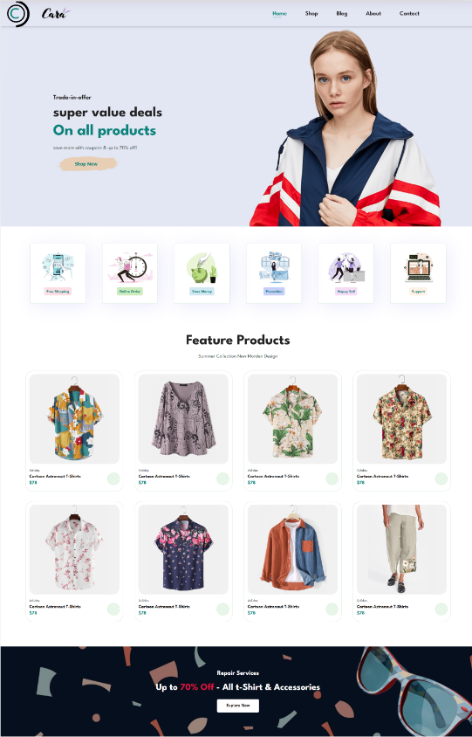
\[CARA\] - A Fashionable Online Experience
Welcome to \[CARA\], your new destination for stylish and affordable fashion. Our e-commerce platform offers a seamless online shopping experience, empowering you to browse, discover, and purchase the latest trends.
Submitted By
Ajay Sharma, Vishal Arya
Submitted To
Simranpreet Kaur Mam

Slide 2
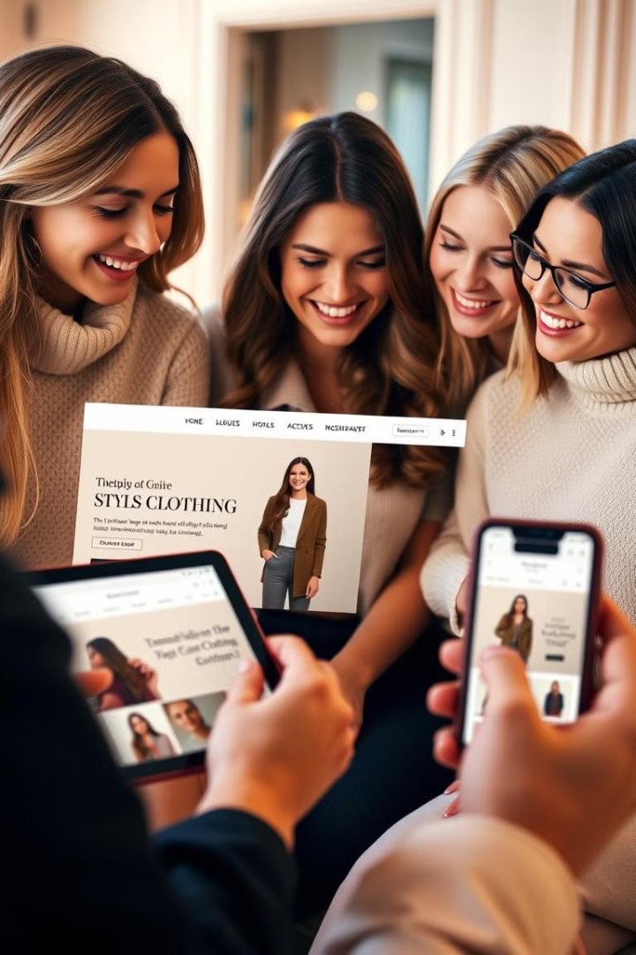
Introduction
At \[Your Clothing Brand Name\], we believe in creating a unique and accessible fashion experience for everyone. Our carefully curated selection of high-quality clothing caters to diverse tastes and styles.
1
Modern and Sleek
2
Responsive Design
Our website is designed with user-friendliness and modern aesthetics in mind.
Enjoy a seamless shopping experience across all devices, ensuring accessibility and convenience.
3
Seamless Checkout
4
Growing Collection
Our secure and intuitive checkout process makes online purchases easy and reliable.
We're continuously adding new styles, ensuring you'll find something to love.

Slide 3
Technologies Used
Our e-commerce website is built on a solid foundation of industry-standard web technologies, ensuring optimal performance, security, and scalability.
HTML
CSS
JavaScript
The backbone of the website, providing structure and organization for the content.
Enhancing the visual appeal with carefully crafted styles, colors, and typography.
Bringing interactivity and dynamic features to life, such as filtering, cart functions, and smooth transitions.

Slide 4

Key Features
We've incorporated a range of key features to make your online shopping experience as enjoyable and efficient as possible.
Product Catalog
Shopping Cart
User Accounts
Browse through our diverse range of clothing items, categorized and subcategorized for easy navigation.
Seamlessly add items to your cart, adjust quantities, and remove items with ease.
Create an account for personalized recommendations, order tracking, and saved items.

Slide 5
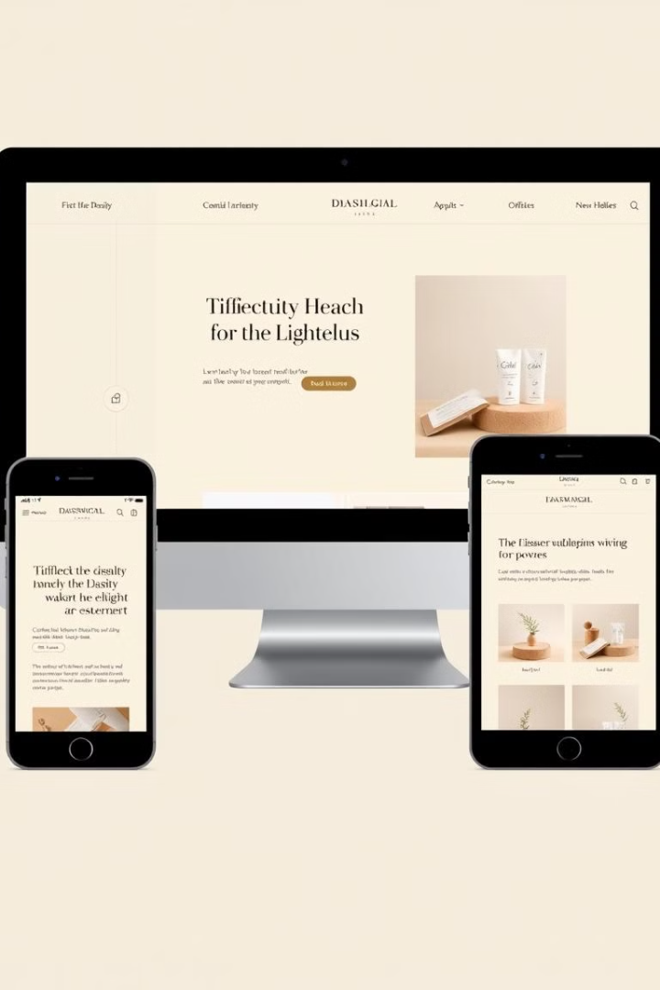



Responsive Design
Our website is designed to adapt to different screen sizes and devices, ensuring a consistent and enjoyable experience regardless of platform.
Media Queries
Utilizing CSS media queries to tailor the styles based on screen size.
Flexible Layouts
Employing CSS Grid and Flexbox for responsive layouts that adapt to different dimensions.
Responsive Images
Optimizing images for different screen sizes to maintain quality and loading speed.

Slide 6

Future Plans
We are constantly striving to improve and expand our online platform, offering our customers the best possible shopping experience.
1
Technology Upgrades
Implementing advanced JavaScript frameworks for enhanced performance and scalability.
2
Content Management System
Utilizing a headless CMS for streamlined content management and flexibility.
3
Market Expansion
Expanding our product range to cater to a wider audience and exploring new markets.
4
Marketing Collaborations
Partnering with influencers and bloggers to promote our brand and reach a broader audience.

Slide 7

Conclusion
At \[Your Clothing Brand Name\], we are dedicated to providing a stylish and effortless online shopping experience. Our user-friendly platform, built with cutting-edge technologies, offers a diverse selection of high-quality clothing, all accessible from the comfort of your home.
Technology
Feature
Benefit
HTML, CSS, JavaScript
Product Catalog, Shopping Cart, User Accounts
Seamless and intuitive shopping experience
Responsive Design
Adaptable layout for different devices
Consistent experience across all platforms

